Slide 1
Formal Correspondence

Slide 2
Business correspondence means the exchange of information in a written format for the process of business activities.
Business correspondence can take place between organizations, within organizations or between the customers and the organization.
The correspondence refers to the written communication between persons.

Slide 3
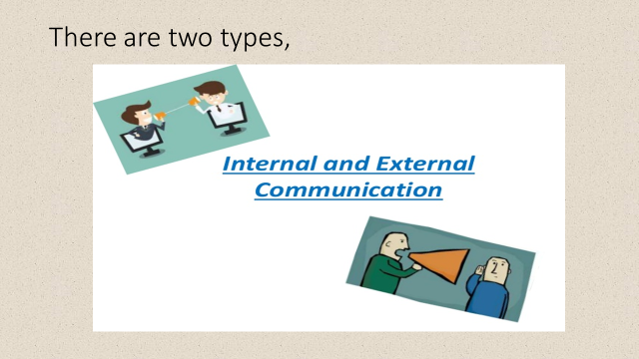
Let’s look at the type of communication in business

Slide 4
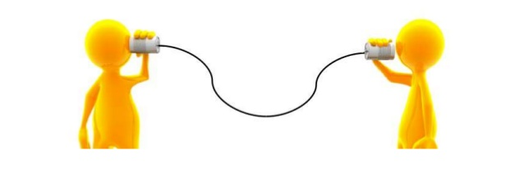
INTERNAL COMMUNICATION
It is the information exchange within the organization.
Messages can be exchanged via personal contact, telephone, e-mail.
Helps employees in performing their work, developing a clear sense of organization mission and identifying and promptly dealing with potential problems.

Slide 5

EXTERNAL COMMUNICATION
Communication that is occurred among the organizations is called the external communication
Organizations communicate with the outside world on a daily basis.
External communication can be formal and informal.

Slide 6

Point to be noted
Internal communication can be formal and informal.

Slide 7

FORMAL INTERNAL COMMUNICATION
There are three modes of formal communication within the organization

Slide 8
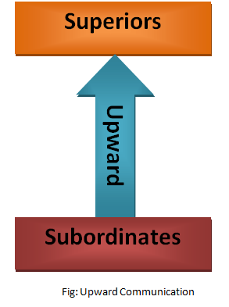
Upward communication: Communication-flows from employees to executives, providing insight into problems, trends, opportunities, grievances, and performance-thus, allowing executives to solve problems and make intelligent decisions.

Slide 9
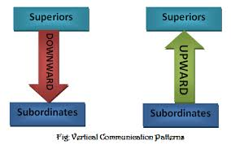
Downward communication: Communication-Flows from executives to employees conveying executive decisions and providing information that helps employees do their jobs

Slide 10
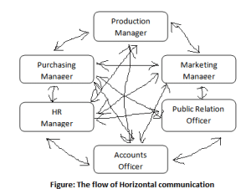
Lateral/horizontal communication: Communication-Flows between departments to help employees share information, coordinate tasks, and solve complex problems.

Slide 11
Now let’s go back to the samples of letter
Sample 1
Dear Mr. Behrens, CEO,
In regard to your request on January 11, the IT department have evaluated the need for new company wide computing equipment. I have enclosed the following report analyzing cost, efficiency and productivity of the 4 proposed brands.
Based on their findings, IT concur that a new line of computers will indeed benefit the company overall. They recommend contracting with Dell to implement the 2013 Office Suite range.
Regards,

Slide 12
Sample 2
Dear Ms. Edwards:
I wanted to take this opportunity to thank you for the excellent job you did in arranging the financial aid for our project. We appreciate the fact the you made yourself available for discussion seven days a week. We were impressed by your thorough knowledge of financing and investment banking.
We have been dealing for our new financing institution for about a week now. The advantages of association with this institution are already apparent. I feel as though we have taken a quantum leap towards the progress.
I would not hesitate to retain your services and to recommend your firm to any company seeking the best representation.
Sincerely yours,
J.A.Wadho

Slide 13
The Types of Correspondence
Memorandum
Formal letters

Slide 14
What is a memorandum?
It is considered as an “inside” correspondence.
It is written to someone in your company

Slide 15
Why do we use memos?
To save something as a written record
To save time
Inexpensive

Slide 16
What are the purposes of memo?
To inform
To inquire
To report
To remind
To promote goodwill

Slide 17
What is the tone of memo?
Informal communication
Writer is likely to be familiar with the reader within organization
A very formal tone might sound intimidating

Slide 18
How to structure a memo?
It has following parts:
Heading
Opening
Body
Closing

Slide 19
Heading
To: (Name and designation of the sender)
From: (Name and designation of the Recipient)
Date: (Complete and current)
Subject: (Topic/subject of memo)

Slide 20
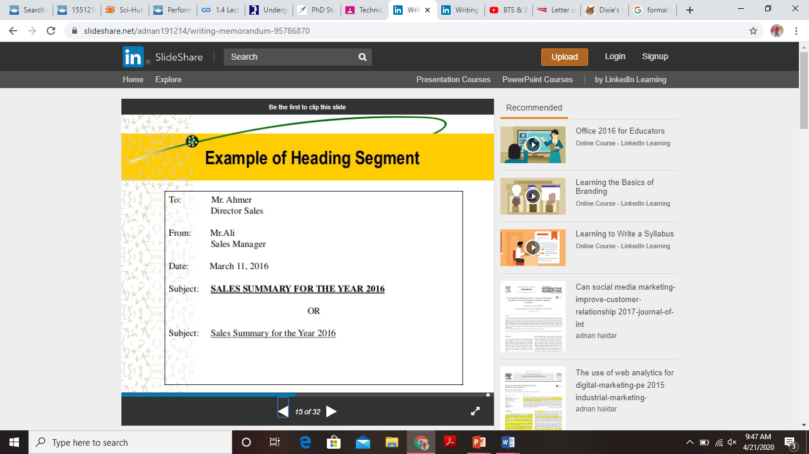

Slide 21
Opening
State the purpose of the memo, give facts.

Slide 22
Body
Single spaced
It describes the main idea of memo, includes details on the said topic

Slide 23
Closing
Make a courteous closing statement
Do not use “yours sincerely”

Slide 24
Examples of Memo

Slide 25
To: All Staff
From: The Manager
Date: May 27, 2010
Subject: Inappropriate use of time on Google Doodle games
Coworkers,
It has come to my attention that many in the office have been spending time on the Google home page microgames. This memo is a reminder to use your work hours for work.
According to a recent article, the estimated daily cost of people collectively playing these games instead of working is over $120 million—which is calculated based on the daily average increased time spent on the Google home page (36 seconds).
If these estimates are applied to our 600 office employees, this results in a nearly $700 weekly loss.
This is a conservative estimate considering the extensive discussions that occur about beating the office's current high score. The extra cost quickly adds up.
Of course, we don't want you to view our organization as a place of drudgery and draconian rules. I encourage a fun and competitive environment, and I recognize that we certainly won't be profitable if you are unhappy or dissatisfied with your jobs. This is just a reminder to be careful with your use of company time.
Thank you,
The Manager
Example 1

Slide 26
To: Computer Programming Division
From: Vice President Lumbergh
Date: February 19, 2016
Subject: Attaching cover sheets to TPS reports
This is to remind the division that, starting today, we are now filing all Testing Procedure Specification (TPS) reports with new cover sheets.
The reason for this change is simple. In addition to a new format, the cover sheets provide a summary of the report as well as the updated legal copy. The new cover sheets also include Initech's new logo.
Though this change may initially seem like a headache and an extra step, it is necessary to include the new cover sheets due to their updated information. Failing to do so will result in a confusing and inaccurate product delivered to our customers.
Please be sure to follow this new procedure.
Best regards,
Vice President Lumbergh
Example 2

Slide 27
Formal letter and formats

Slide 28
Three approaches to be used
Direct
Indirect
AIDA

Slide 29
Direct Requests (Direct approach)
The direct request message asks the reader to do something that s/he is inclined to do:
placing an order
making business reservations and appointments
requesting action related to routine business procedures
making claims requests for adjustment (about damaged, faulty, wrong or late goods)
making complaints (about poor service, unfair billing, impolite letters)
inquiring about products and services
inquiring about persons (references by a person interested in an applicant.)

Slide 31
Bad news Messages (Indirect approach)
Bad news messages convey bad news for the reader. These are messages that will not be received favorably by our reader. Bad news messages say “no”:
conveying negative news about claims adjustments
refusing credit
declining requests or favors
conveying bad news about requests
turning down an applicant for a job, scholarship, promotion, etc.
conveying news about price increases

Slide 33

Point to be noted
Bad news messages must be written carefully so as not to cause the reader to break off relations completely. Since we know that reader will be irritated, angry or disappointed.

Slide 34
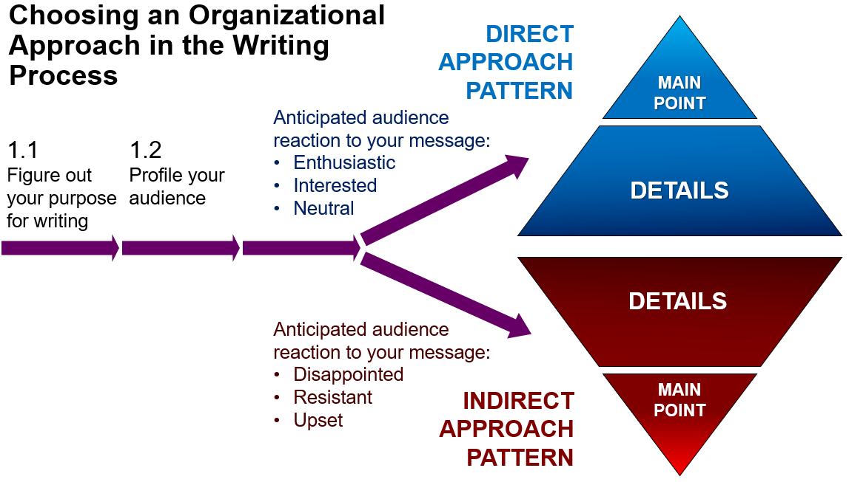

Slide 35
Persuasive Request Messages
Persuasive requests are messages that ask the reader to do something that s/he is inclined NOT to do:
request for favors and help
request for donations
request for cooperation (on projects and goals)
requests that require special privilege (such as for credit or adjustments not covered by the warranty)
requests that require the company to make an exception for you or change in policy or performance
sales letters

Slide 36

Since the reader automatically wants to refuse our request, we need to convince him/her of the benefits of doing what we’re asking. Therefore, the direct approach will not be effective. Instead, use the AIDA formula.

Slide 37
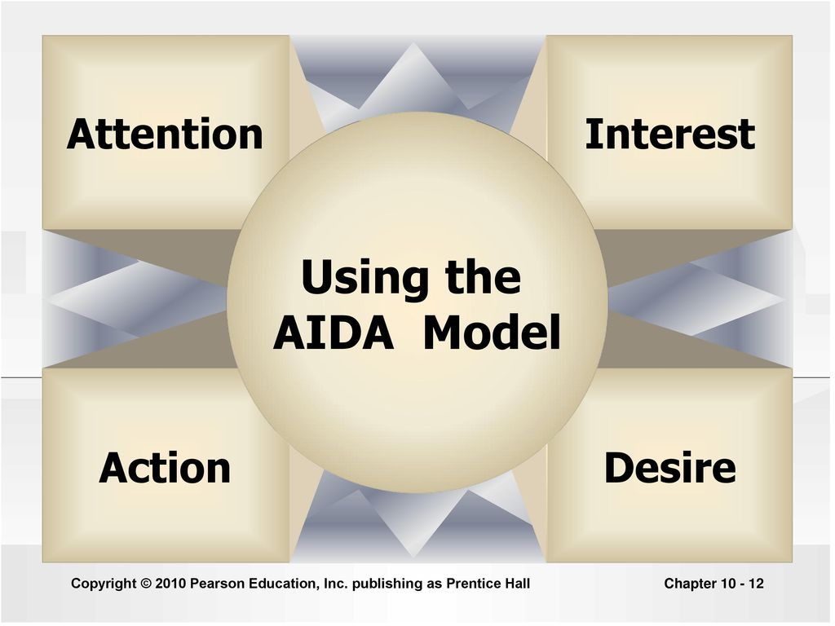
What is AIDA?

Slide 39
3 types of format,
Full Block
Modified Block
Semi-Block

Slide 40
Full block
Block format features all elements of the letter aligned to the left margin of the page.
It has a neat and simple appearance.
Paragraphs are separated by a double line space.

Slide 41
Sender's address
Sender's phone number
Today's date (drop down 4 lines)
Recipient's name
Recipient's company name
Recipient's address (2 space)
Dear Name:(1 space)
In this type of block letter, all the paragraphs line up at the left margin. There is no indenting of the paragraphs. The margins should be set to 1-1.5" all the way around the page. If you are using company letterhead, you will need to account for that in figuring the margin where the letterhead is placed on the page. (1 line space)
Format sample

Slide 42
Contd.
You only need to single-space between sentences. Leave an extra open line between paragraphs. Keep in mind that these sample letters are a guideline. People often customize to meet their preferred style. (1 line space) Some people choose to center the above sender information.
(2 line space) Sincerely,
(space down four lines)
Signature here
add name,
add title
[Identification initials]

Slide 43
20-54 Jackson Avenue
Brooklyn, NY 11352
June 28, 2007
Ms. Jennifer Esposito
John Doe Fellowship
595 Park Avenue
New York, NY 10021
Dear Ms. Esposito:
The John Doe Fellowship has always loomed on the horizon for me. Ever since I decided to major in history, I have wanted to participate in your program. From the research that I have done, I believe that your program provides its participants with an extensively detailed look at the history of the world through hands-on experience with fossils, artifacts, and other remains that compose the blueprint of our existence. I am applying for the John Doe Fellowship because I believe that it would benefit me throughout my career and allow me to further understand the ideas behind history and how it is constructed. I am a very committed and goal-oriented person with excellent interpersonal skills. My background in history involves studying many different eras and time periods. My specialty, though, is the archeological study of the ancient world and its history. During the summer of 2004 and 2005, I interned at the Metropolitan Museum of Art as a tour guide. Both times, I not only utilized my knowledge of art and its history, but I also learned a lot about how that history was constructed.
This experience has influenced me to intern as a tour guide at the American Museum of Natural History, where my love for the origins of history and learning from the tactile experience with artifacts increased. In the future, I would like to participate in historical research and eventually become a full-time professor of history. I believe my skills, experience, and goals make me an excellent candidate for your program.

Slide 44
This experience has influenced me to intern as a tour guide at the American Museum of Natural History, where my love for the origins of history and learning from the tactile experience with artifacts increased. In the future, I would like to participate in historical research and eventually become a full-time professor of history. I believe my skills, experience, and goals make me an excellent candidate for your program.
This experience has influenced me to intern as a tour guide at the American Museum of Natural History, where my love for the origins of history and learning from the tactile experience with artifacts increased. In the future, I would like to participate in historical research and eventually become a full-time professor of history.
I believe my skills, experience, and goals make me an excellent candidate for your program.
Thank you very much for considering me for the John Doe Fellowship. I am
looking forward to hearing from you.
Sincerely,
Bill Lurie
(419) 352-5425
Enclosure

Slide 45
Modified block format
Modified block differs from block style in that the date, sign off, and signature lines begin at the center point of the page line.
The beginning of each paragraph is indented five spaces, along with the subject line, if used. Depending on the length of the letter, paragraphs may be separated by a single or double line space.

Slide 46
123 Corona Blvd.
Flushing, NY 1123
July 3, 2007
Dr. Steven Serafin,
Director Reading/Writing Center
Hunter College
695 Park Ave
New York, NY 10065
Dear Dr. Serafin:
My name is Sally Eisner. I am writing this appeal to request a 4th chance to take the CUNY Proficiency Exam in June of 2007. I have taken the exam twice and missed it once. The first time, I feel that I was simply unprepared. I did not realize that I should have attended CPE workshops offered at the Reading/Writing Center. The second time, I attended the workshops and learned more about the exam; however, my Task 2 score was unsatisfactory, so I failed again. Finally, I registered for CPE tutoring at the Reading/Writing Center and studied very hard for the third time. However, on the Saturday of the exam, I had a family emergency, which caused me to miss the date. I had forgotten that I could defer the test date until after I missed it.

Slide 47
Now, I am working hard to build on my academic skills. After a consultation with a CPE advisor at the Reading/Writing Center, I have a clear vision of what I should do in order to pass the exam. Again, I have registered for a semester of CPE tutoring at the Writing/Reading Center that I plan to attend weekly.
I would really like to have a 4th chance to pass this exam because I am confident that if I work hard, I can do it. Thank you very much for considering my appeal. I hope to hear back from you soon.
Sincerely,
Sally Eisner

Slide 48
Semi-Block format
It is similar to the modified block format, except that the first line of each paragraph is indented.
This format is more conventional for informal personal letters in which we want to exude a warm, relaxed and friendly correspondence style.

